Slide 1
Object Oriented Programming CS F213

Slide 2
Contents
What is UML ?
Basic Modelling Steps
UML Diagrams
Use-case diagrams
Class diagram
Sequence diagram
State transition diagram
Sources (Slide 3 to 44] :
http://www.math.uaa.alaska.edu/~afkjm/cs401/handouts
http://www.utdallas.edu/~chung/RE
https://www.uml-diagrams.org/index-examples.html (Refer for more UML examples)
https://tallyfy.com/uml-diagram/

Slide 3
What is UML?
Unified Modeling Language
OMG Standard, Object Management Group
Based on work from Booch, Rumbaugh, Jacobson
UML is a modeling language to express and design documents, software
Particularly useful for OO design
Not a process, but some have been proposed using UML
Independent of implementation language

Slide 4
Basic Modeling Steps
Use Cases
Capture requirements
Domain Model
Capture process, key classes
Design Model
Capture details and behaviors of use cases and domain objects
Add classes that do the work and define the architecture

Slide 5
UML Diagrams
Use Case Diagrams
Class Diagrams
Sequence (Interaction) Diagram
State Transition Diagrams

Slide 6
Use Case Diagrams
Used during requirements elicitation to represent external behavior
Actors represent roles, that is, a type of user of the system
Use cases represent a sequence of interaction for a type of functionality; summary of scenarios
The use case model is the set of all use cases. It is a complete description of the functionality of the system and its environment
Passenger
PurchaseTicket

Slide 7
Actors
An actor models an external entity which communicates with the system:
User
External system
Physical environment
An actor has a unique name and an optional description.
Examples:
Passenger: A person in the train
GPS satellite: Provides the system with GPS coordinates
Passenger

Slide 8
Use Case
A use case represents a class of functionality provided by the system as an event flow.
A use case consists of:
Unique name
Participating actors
Entry conditions
Flow of events
Exit conditions
Special requirements
PurchaseTicket

Slide 9
Use Case Diagram: Example
Name: Purchase ticket
Participating actor: Passenger
Entry condition:
Passenger standing in front of ticket distributor.
Passenger has sufficient money to purchase ticket.
Exit condition:
Passenger has ticket.
Event flow:
1. Passenger selects the number of zones to be traveled.
2. Distributor displays the amount due.
3. Passenger inserts money, of at least the amount due.
4. Distributor returns change.
5. Distributor issues ticket.
Anything missing?
Exceptional cases!

Slide 10
The <<extends>> Relationship
<<extends>> relationships represent exceptional or seldom invoked cases.
The exceptional event flows are factored out of the main event flow for clarity.
Use cases representing exceptional flows can extend more than one use case.
The direction of a <<extends>> relationship is to the extended use case
Passenger
PurchaseTicket
<<extends>>
<<extends>>
<<extends>>
OutOfOrder
<<extends>>
TimeOut
Cancel
NoChange

Slide 11
The <<includes>> Relationship
<<includes>> relationship represents behavior that is factored out of the use case.
<<includes>> behavior is factored out for reuse, not because it is an exception.
The direction of a <<includes>> relationship is to the using use case (unlike <<extends>> relationships).
Passenger
PurchaseMultiCard
PurchaseSingleTicket
<<includes>>
<<includes>>
<<extends>>
CollectMoney
<<extends>>
NoChange
Cancel

Slide 12
Use Cases are useful to…
Determining requirements
New use cases often generate new requirements as the system is analyzed and the design takes shape.
Communicating with clients
Their notational simplicity makes use case diagrams a good way for developers to communicate with clients.
Generating test cases
The collection of scenarios for a use case may suggest a suite of test cases for those scenarios.

Slide 13
Use Case Diagrams: Summary
Use case diagrams represent external behavior
Use case diagrams are useful as an index into the use cases
All use cases need to be described for the model to be useful.

Slide 14
Class Diagrams
Gives an overview of a system by showing its classes and the relationships among them.
Class diagram are static.
Also shows attributes and operations of each class
Good way to describe the overall architecture of system components

Slide 15
Class Diagram Perspectives
We draw Class Diagrams under three perspectives
Conceptual
Software independent
Language independent
Specification
Focus on the interfaces of the software
Implementation
Focus on the implementation of the software

Slide 16
Classes – Not Just for Code
TariffSchedule
Table zone2price
Enumeration getZones()
Price getPrice(Zone)
Name
TariffSchedule
Attributes
Signature
zone2price
getZones()
getPrice()
Operations
TariffSchedule
A class represent a concept
A class encapsulates state (attributes) and behavior (operations).
Each attribute has a type.
Each operation has a signature.
The class name is the only mandatory information.

Slide 17
Instances
tarif_1974:TariffSchedule
zone2price = {
{‘1’, .20}, {‘2’, .40},
{‘3’, .60}}
An instance represents a phenomenon.
The name of an instance is underlined and can contain the class of the instance.
The attributes are represented with their values.

Slide 18
UML Class Notation
A class is a rectangle divided into three parts
Class name
Class attributes (i.e. data members, variables)
Class operations (i.e. methods)
Modifiers
Private: -
Public: +
Protected: #
Static: Underlined (i.e. shared among all members of the class)
Abstract class: Name in italics

Slide 19
UML Class Notation
Lines or arrows between classes indicate relationships
Association
A relationship between instances of two classes, where one class must know about the other to do its work, e.g. client communicates to server
indicated by a straight line or arrow
Aggregation
An association where one class belongs to a collection, e.g. instructor part of Faculty
Indicated by an empty diamond on the side of the collection
Composition
Strong form of Aggregation
Lifetime control; components cannot exist without the aggregate
Indicated by a solid diamond on the side of the collection
Inheritance
An inheritance link indicating one class a superclass relationship, e.g. bird is part of mammal
Indicated by triangle pointing to superclass

Slide 20

Binary Association
Binary Association: Both entities “Know About” each other
myB.service();
myA.doSomething();
Optionally, may create an Associate Class

Slide 21

Unary Association
A knows about B, but B knows nothing about A
myB.service();
Arrow points in direction
of the dependency

Slide 22

Aggregation
Aggregation is an association with a “collection-member” relationship
void doSomething() aModule.service();
Hollow diamond on
the Collection side
No sole ownership implied

Slide 23
Composition
Composition is Aggregation with:
Lifetime Control (owner controls construction, destruction)
Part object may belong to only one whole object
members[0] = new Employee();
…
delete members[0];
Filled diamond on side of the Collection

Slide 24
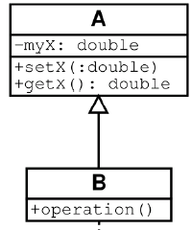
Inheritance
Standard concept of inheritance
Base Class
Derived Class
class B() extends A
…

Slide 25
UML Multiplicities
Links on associations to specify more details about the relationship
Multiplicities | Meaning
0..1 | zero or one instance. The notation n . . m indicates n to m instances.
0..* or * | no limit on the number of instances (including none).
1 | exactly one instance
1..* | at least one instance

Slide 26
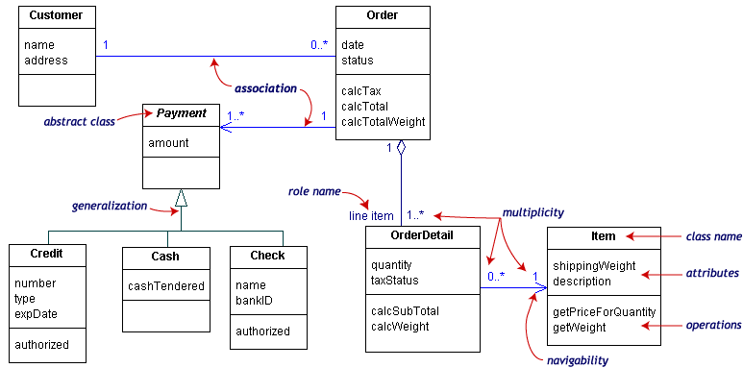
UML Class Example

Slide 27
Association Details
Can assign names to the ends of the association to give further information
Team
-
Employee
group
-
Name
-
:
string
members
:
Employee
-
individual
+
ID
:
long
#
Salary
1
:
double
-
adfaf
*
:
bool
+
getName
() :
string
+
setName
()
-
calcInternalStuff
(
in x
:
byte
,
in y
:
decimal
)

Slide 28
Interaction Diagrams
Interaction diagrams are dynamic -- they describe how objects collaborate.
A Sequence Diagram:
Indicates what messages are sent and when
Time progresses from top to bottom
Objects involved are listed left to right
Messages are sent left to right between objects in sequence

Slide 29
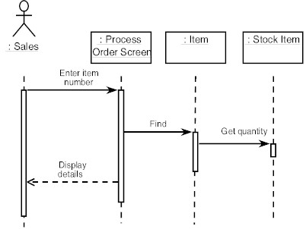
Sequence Diagram Format
Actor from
Use Case
Objects
1
Activation
2
3
4
Lifeline
Calls = Solid Lines
Returns = Dashed Lines

Slide 30
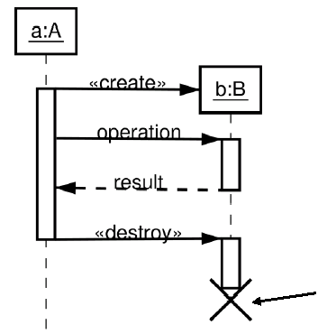
Sequence Diagram : Destruction
Shows Destruction of b
(and Construction)

Slide 31
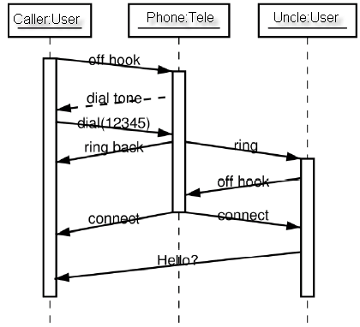
Sequence Diagram : Timing
Slanted Lines show propagation delay of messages
Good for modeling real-time systems
If messages cross this is usually problematic – race conditions

Slide 32
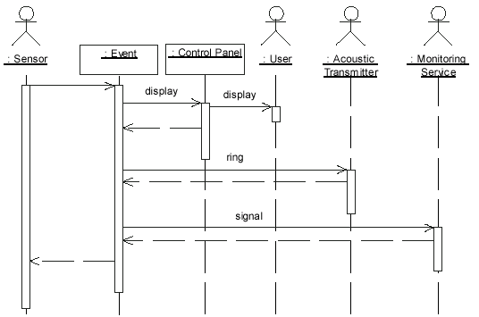
Sequence Example: Alarm System
When the alarm goes off, it rings the alarm, puts a message on the display, notifies the monitoring service

Slide 33
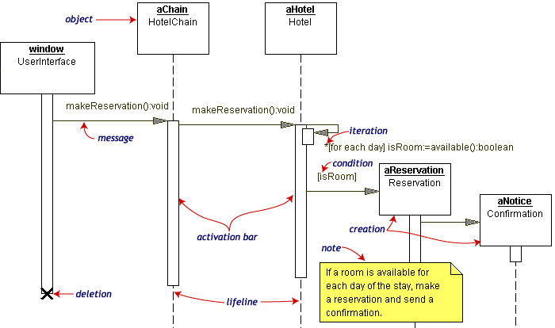
Sequence Diagram Example
Hotel Reservation

Slide 34
State Transition Diagrams
Shows the possible states of the object and the transitions that cause a change in state
i.e. how incoming calls change the state
Notation
States are rounded rectangles
Transitions are arrows from one state to another. Events or conditions that trigger transitions are written beside the arrows.
Initial and Final States indicated by circles.
Final state terminates the action; may have multiple final states

Slide 35
State Representation
The set of properties and values describing the object in a well defined instant are characterized by
Name
Activities (executed inside the state)
Do/ activity
Actions (executed at state entry or exit)
Entry/ action
Exit/ action
Actions executed due to an event
Event [Condition] / Action ^Send Event

Slide 36
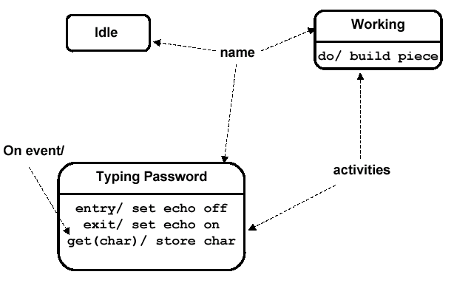
Notation for States

Slide 37
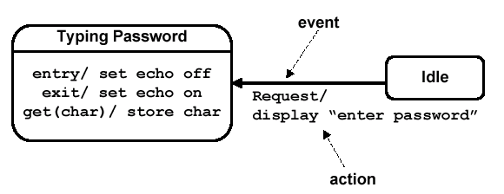
Simple Transition Example

Slide 38
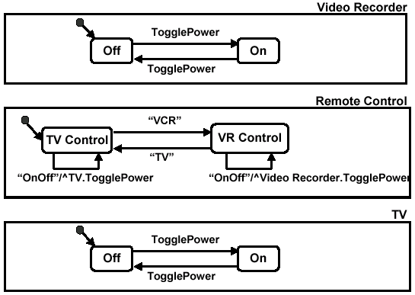
More Simple State Examples

Slide 39
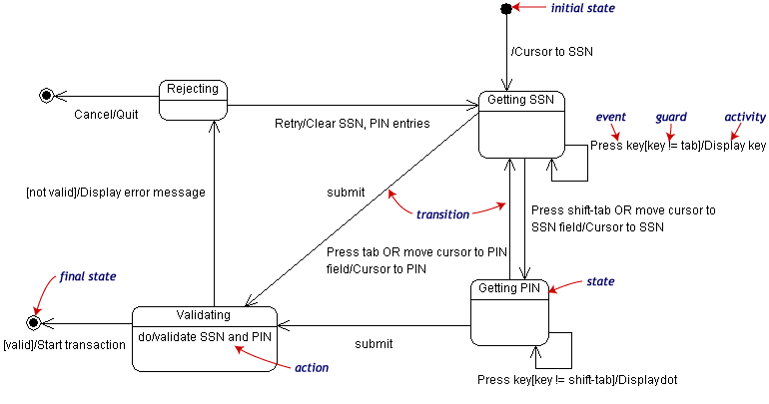
State Transition Example
Validating PIN/SSN

Slide 40
State Charts – Local Variables
State Diagrams can also store their own local variables, do processing on them
Library example counting books checked out and returned

Slide 41
Example: Use case diagrams
Package
Use case
Watch
Actor
ReadTime
WatchUser
SetTime
WatchRepairPerson
ChangeBattery
Use case diagrams represent the functionality of the system
from user’s point of view

Slide 42
Example : Class diagrams
Class diagrams represent the structure of the system
Association
Class
Multiplicity
Watch
1
1
1
1
2
1
2
1
PushButton
LCDDisplay
Battery
load
Time
now
state
blinkIdx
blinkSeconds()
blinkMinutes()
blinkHours()
stopBlinking()
referesh()
push() release()
Attribute
Operations

Slide 43
Example: Sequence diagram
Actor
Object
:WatchUser
:Watch
:LCDDisplay
:Time
pressButton1()
blinkHours()
pressButton1()
blinkMinutes()
Message
pressButton2()
incrementMinutes()
refresh()
pressButtons1And2()
commitNewTime()
stopBlinking()
Activation
Lifeline
Sequence diagrams represent the behavior as interactions

Slide 44
Example: State diagrams
State
Event
Initial state
Transition
Final state
Represent behavior as states and transitions

Slide 45
Thank you.

